Slide 1
Welcome to the presentation CHE-109
.

Slide 2
1.Tamim Hasan Saykat
ID - 2022-1-60-289
2. Abrar hossain Zahin
ID - 2022-2-60-040
3.Umme Sumaya
2022-2-60-035

Slide 3
Nuclear Energy
Energy Generation Process

Slide 4
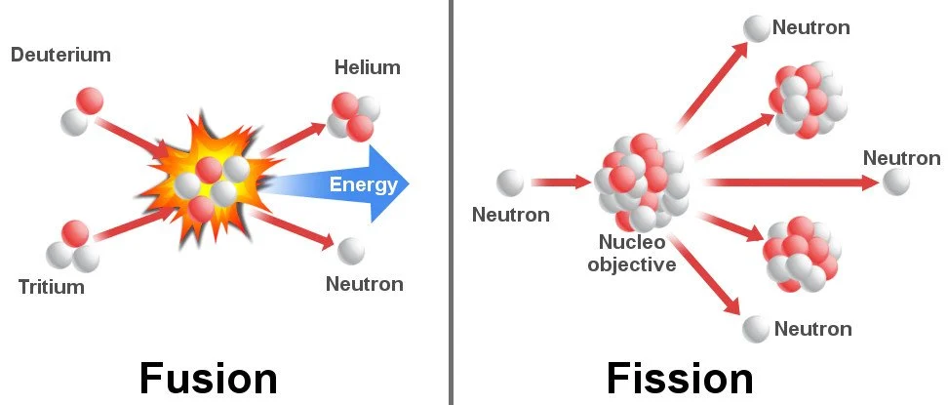
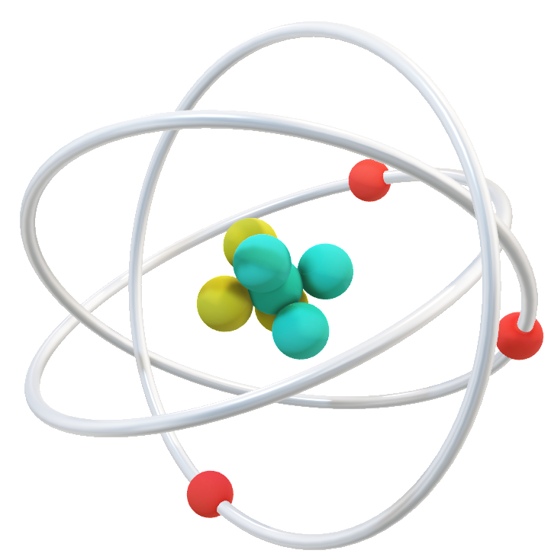
What is Nuclear Energy ?
Nuclear energy
Fission
Fusion
Nuclear fission, the division of atoms takes place to form smaller atoms by releasing energy. Nuclear power plants produce energy using nuclear fission.
The Sun produces energy using the mechanism of nuclear fusion.

Slide 5
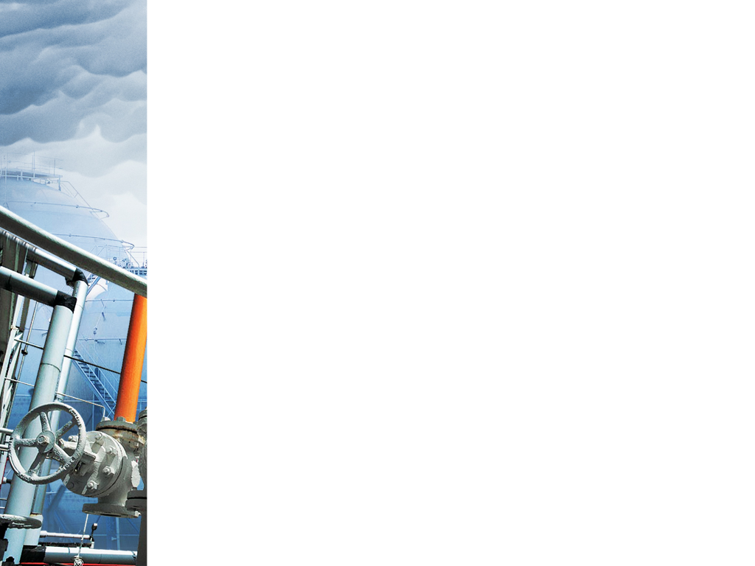
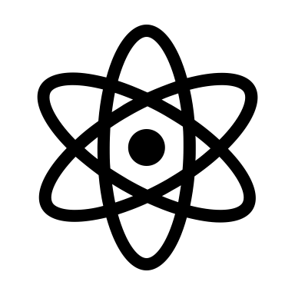


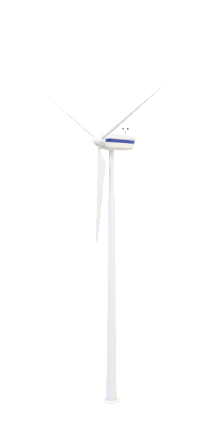
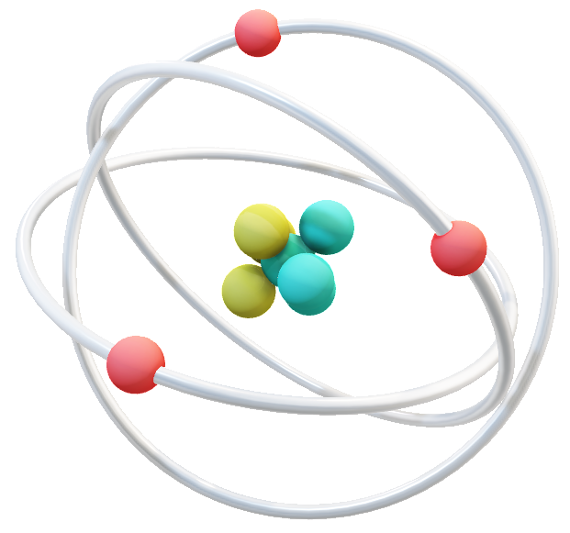
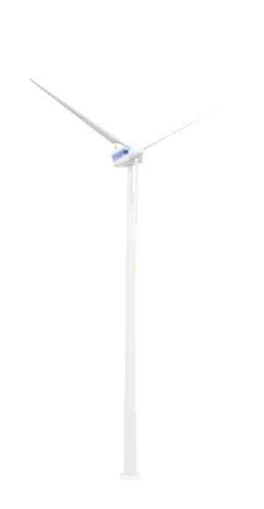
Now We Will Describe The Ruppur Power Plant Energy Generation Process Steps By Steps
👉$👉$👉👉

Slide 6

About Ruppur………..
Ruppur
VVER-1200 water-cooled
Stabilty High
Two units will generate 2400 MW of electricity
Biggest Project
Carbon free electricity source
Energy by 1 gm ₉₂U²³⁵ = 2.5 millon times energy by burning of coul

Slide 7
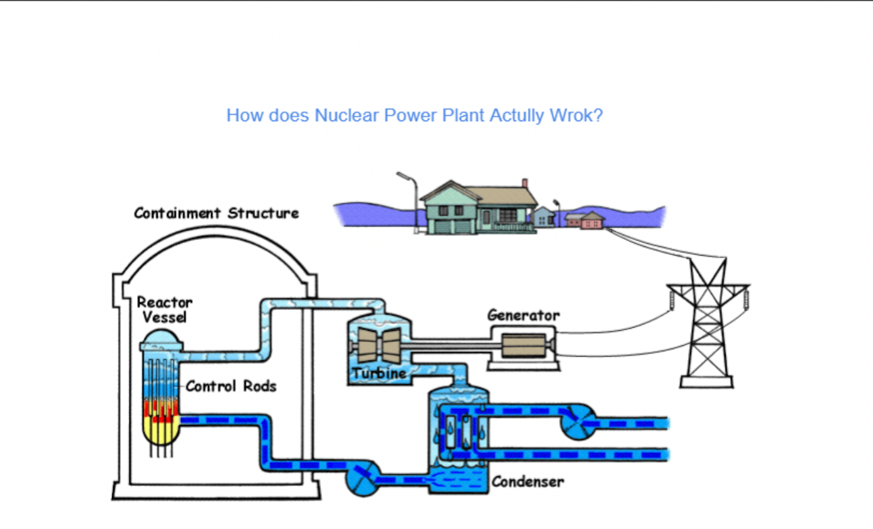

Slide 8
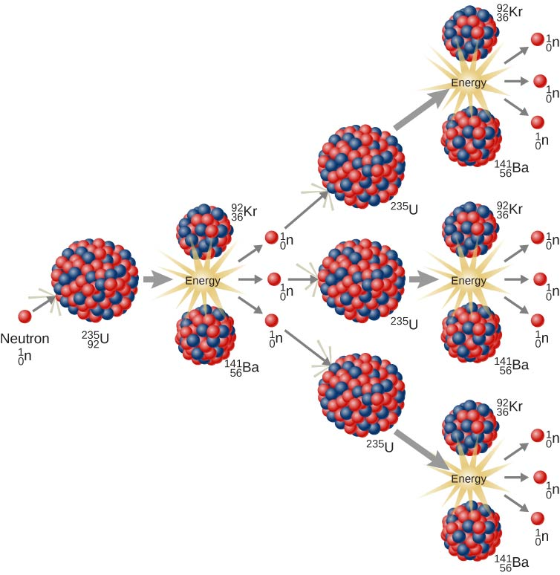
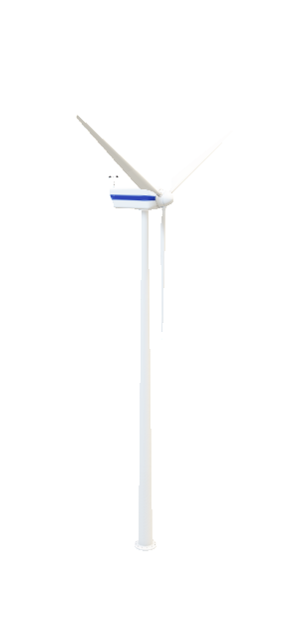
How do we get energy in Nuclear Power Plant?
Heat Energy is Generated in Reactor through Nuclear Fission Reaction.
What is Nuclear Fission ? Lets Explain: In Reactor Vessel,we take U235 atom and U235 is an Unstable Materials.Here,1 Neutron Collide with 1 U235 atom.Which Converts to U236 and it is more than Unstable Materials. Due to Which its breaks Down and produces kr, Ba, 3 Neutrons and much more Heat energy.
This 3 Neutrons Collide with 3 more U235 and Producing Much More Energy.
Example: Breaking 1 U235 Atom Produces: 200M ev.

Slide 9
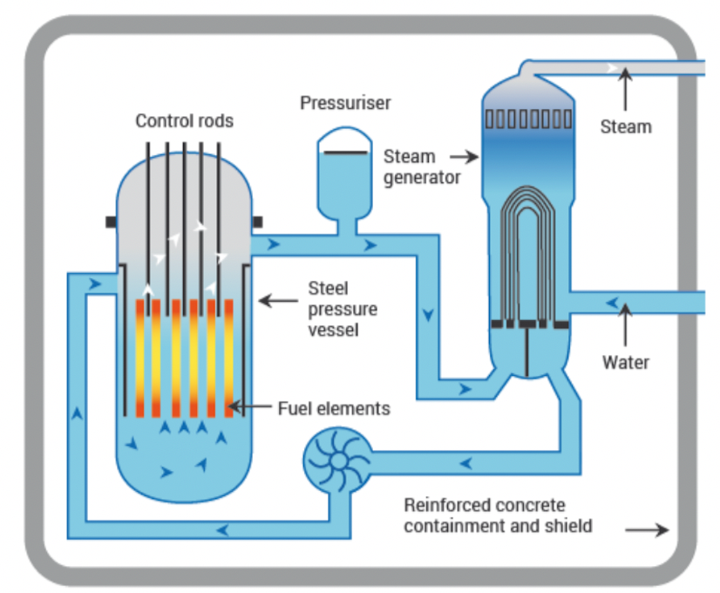
Thus the Chain Reaction Starts at a Geometric Rate and a Large amount of Heat Energy is Generated in the Reactor. Thats Called, Neclear Fission Reaction. This Nuclears Fission Rection Produces a Large amount of Heat Energy, Which is Controlled by Control Rods in the Middle of the Reactor.
The Entire Reactor is Filled With Heavy Water. The Heat Energy from Nuclear Fission Heats the water inside the Reactor. Then, Coolant absorbs the Generated Heat Energy and this Energy Flow to the Stem Generator. Stem Generator is Filled with water. This Water Converts into stem due to the high Heat Energy. The Generated Stem Flows into the turbine and turns the turbine Blades

Slide 10
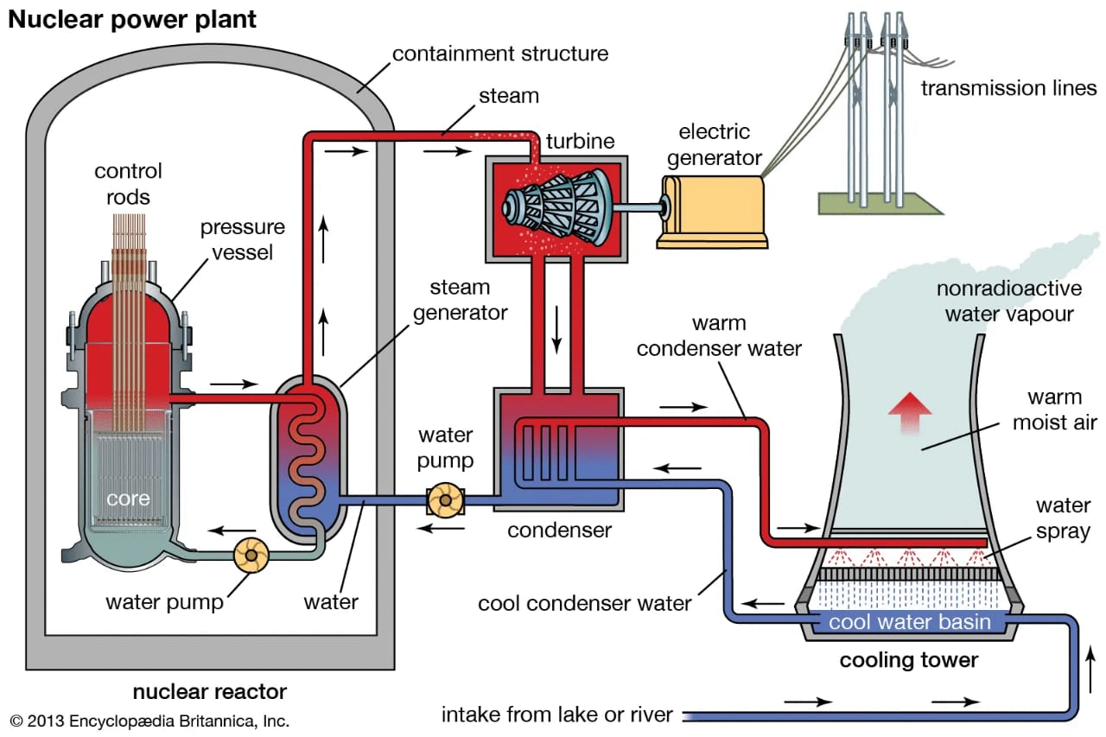
A Drive is Connected to the turbine and this drive is connects to our Generator As the drive Rotates, so the Alternator inside the Generator Rotates And as the result of this Rotation, Electricity is Generated. So, Electricity is Generated through this process and this process is Ongoing.Finally, This Generated Electricity Reaches Our House Through the Transformer.

Slide 11

Is Nuclear energy useful for us ?
Clean source of energy which generates power
It can help our economy
It has social benefits
Affordability

Slide 12
Is Nuclear energy environment friendly ?
It protects air quality
It is inexpensive
It doesn’t require too much fuel
It is completely safe

Slide 13



This Nuclear power also has some downsides !
These negative aspects affect our environment
Negative impact on land
It contaminates water
Negative impact on human-health
nuclear related work also produces a lot of waste materials that are thrown around nuclear power point
dumping the radioactive waste of nuclear power point in water surface causes water pollution.
High radiation by nuclear powerplant can cause immediate damage to persons body because radiation floated into the air

Slide 14
Thank you all for watching our presentation
Do you have any question for us ?

